Slide 1



Python Bootcamp Toolboxes
PhD Bruno C. Quint
bquint@ctio.noao.edu
Resident Astronomer at SOAR Telescope
https://github.com/b1quint/PythonBootcamp2017

Slide 2
Table of Contents
iPython
Jupyter
PyCharm

Slide 3
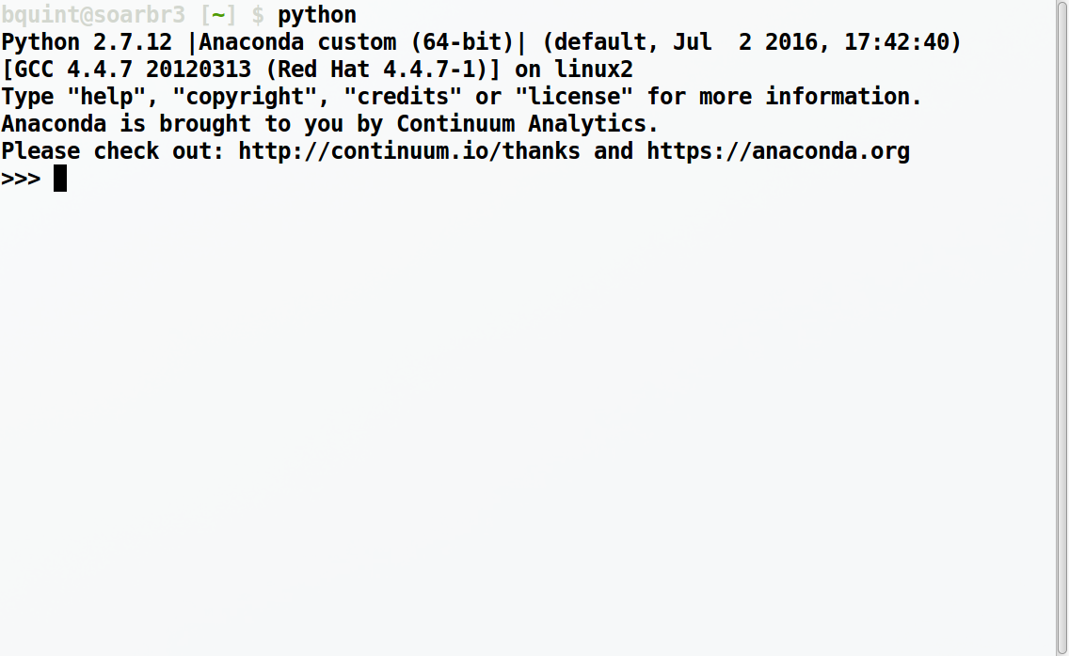
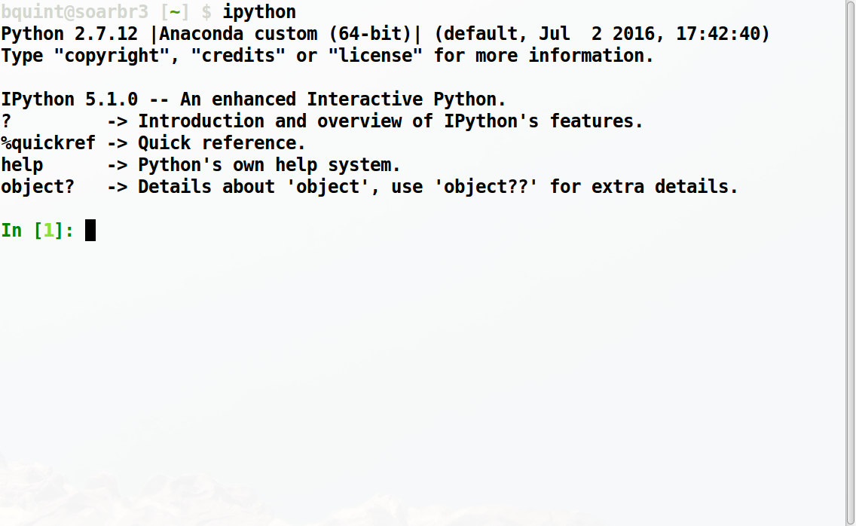
Python Vs iPython

Slide 4
Python Vs iPython

Slide 5
Python Vs iPython

Slide 6
Python Vs iPython

Slide 7
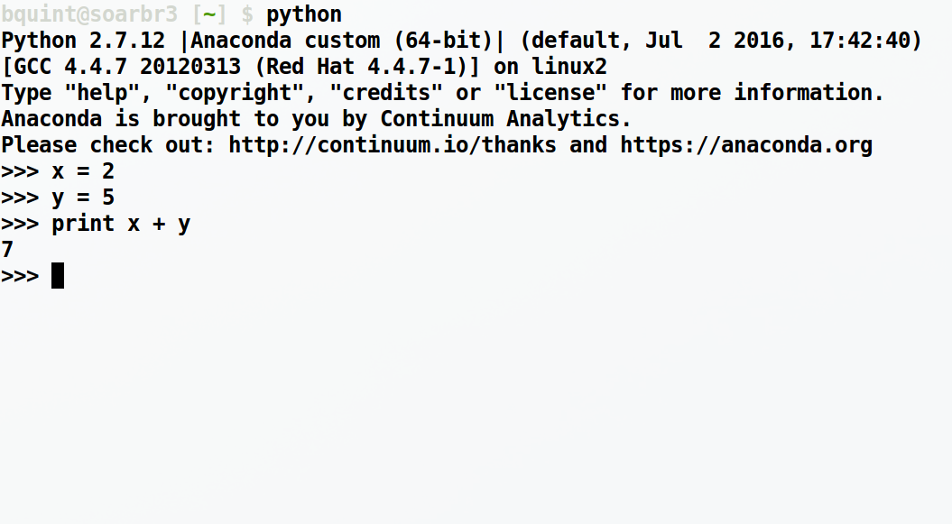
Python Vs iPython

Slide 8
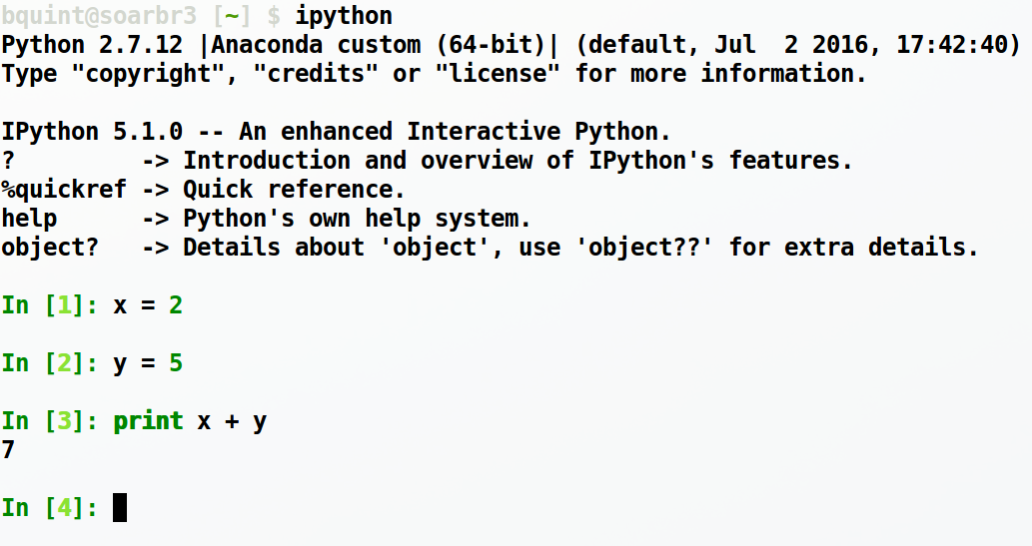
Python Vs iPython
Colors!!

Slide 9
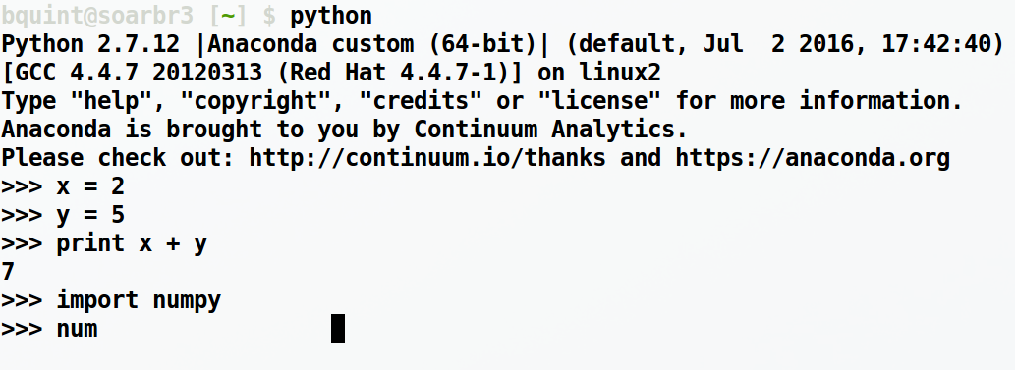
Python Vs iPython
Tab Completion
Tab pressed 3x

Slide 10
Python Vs iPython
Tab Completion
Tab pressed 3x

Slide 11
Python Vs iPython
Tab Completion
Tab pressed 3x
:-(

Slide 12
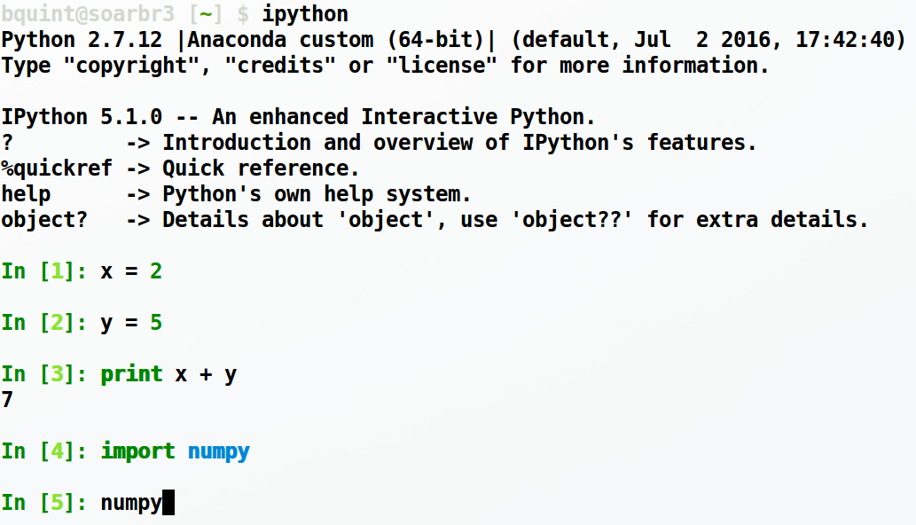
Python Vs iPython
Tab Completion
:-)
Tab pressed 1x

Slide 13
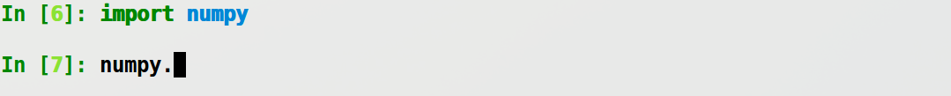
Python Vs iPython
Tab Completion

Slide 14
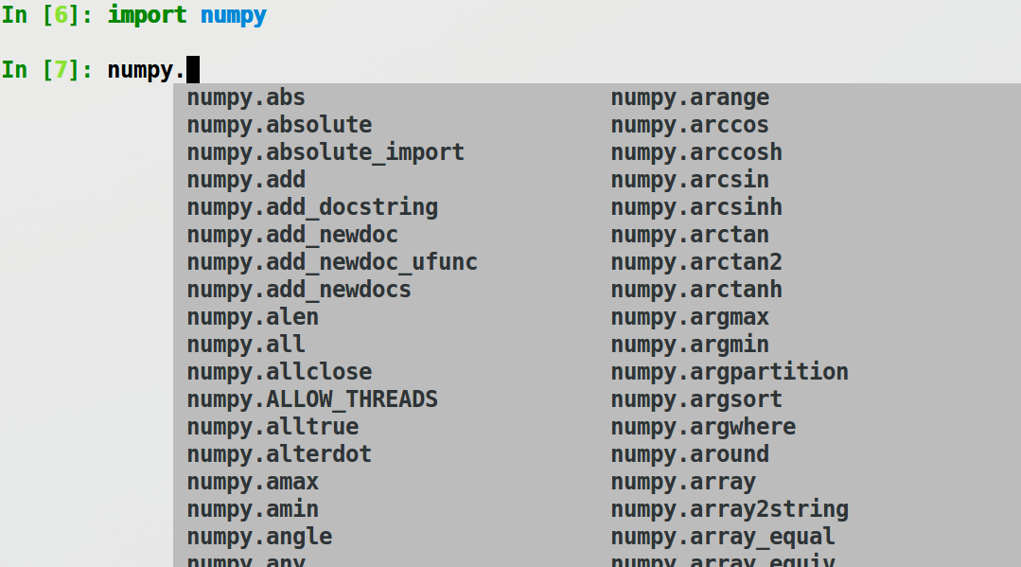
Python Vs iPython
Tab Completion

Slide 15


Python Vs iPython
Help with (i)Python

Slide 16
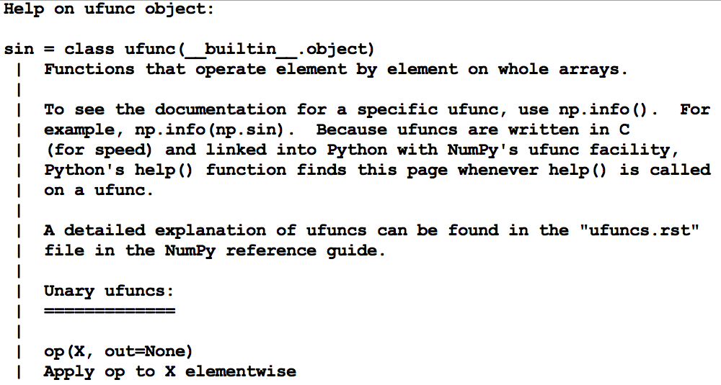
Python Vs iPython
Help with Python

Slide 17
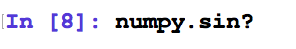
Python Vs iPython
Help with iPython

Slide 18
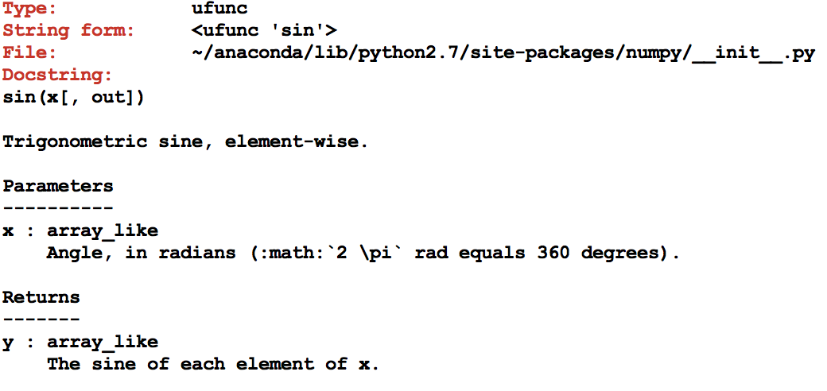
Python Vs iPython
Help with iPython

Slide 19
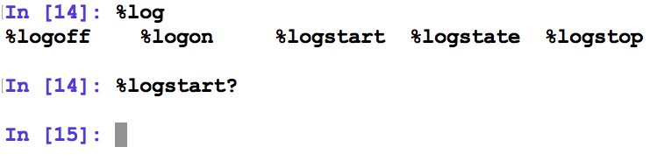
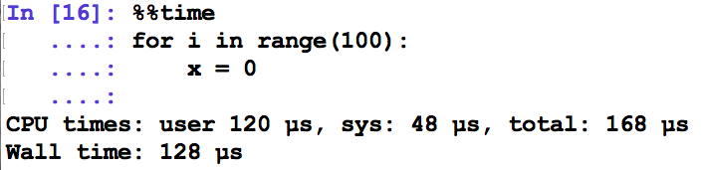
Python Vs iPython
Magic Functions

Slide 20
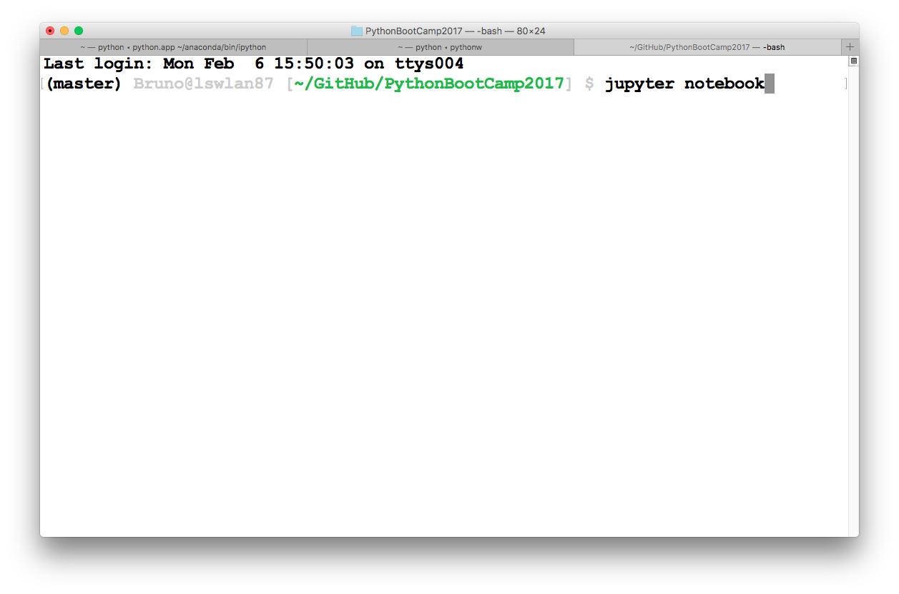
Jupyter / iPython Notebook

Slide 21
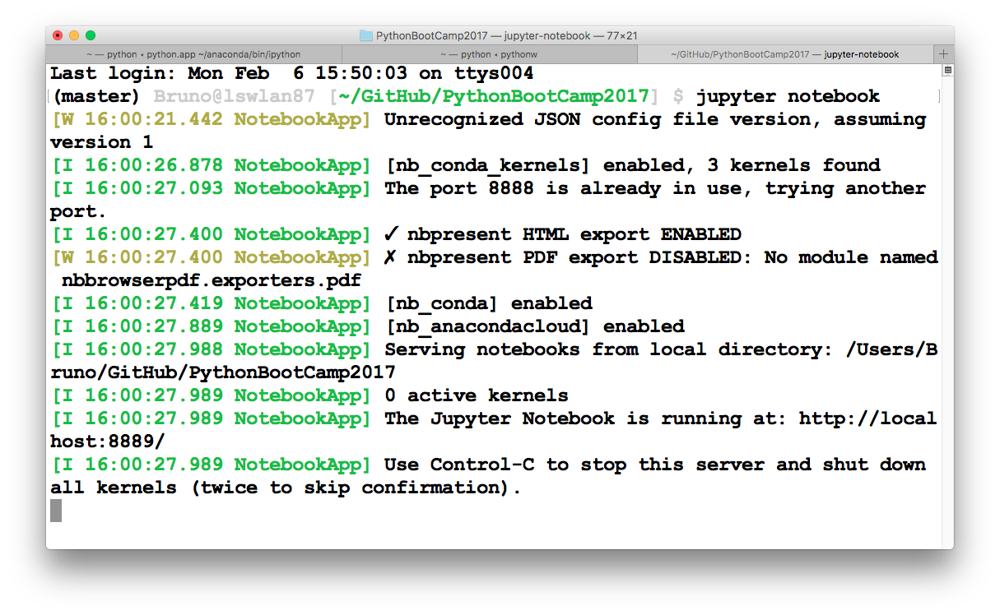
Jupyter / iPython Notebook

Slide 22
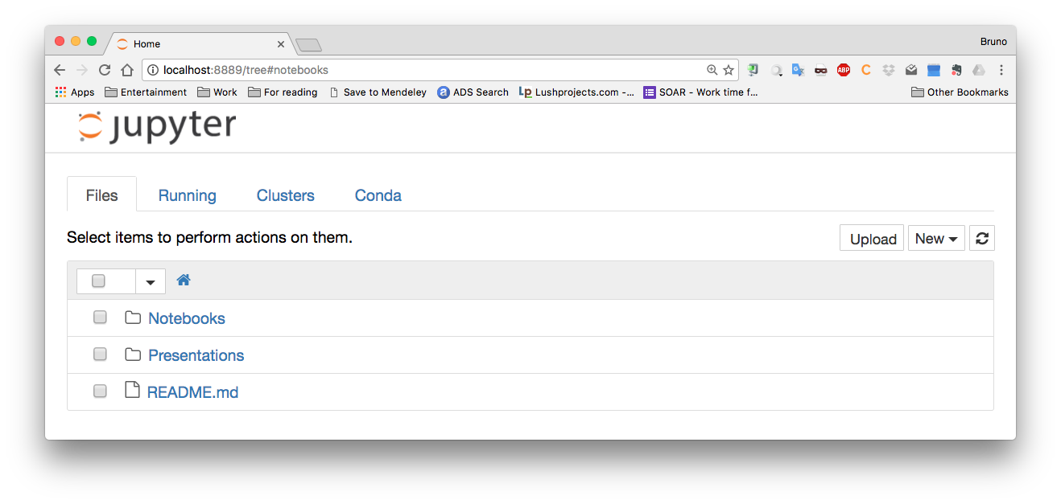
Jupyter / iPython Notebook

Slide 23
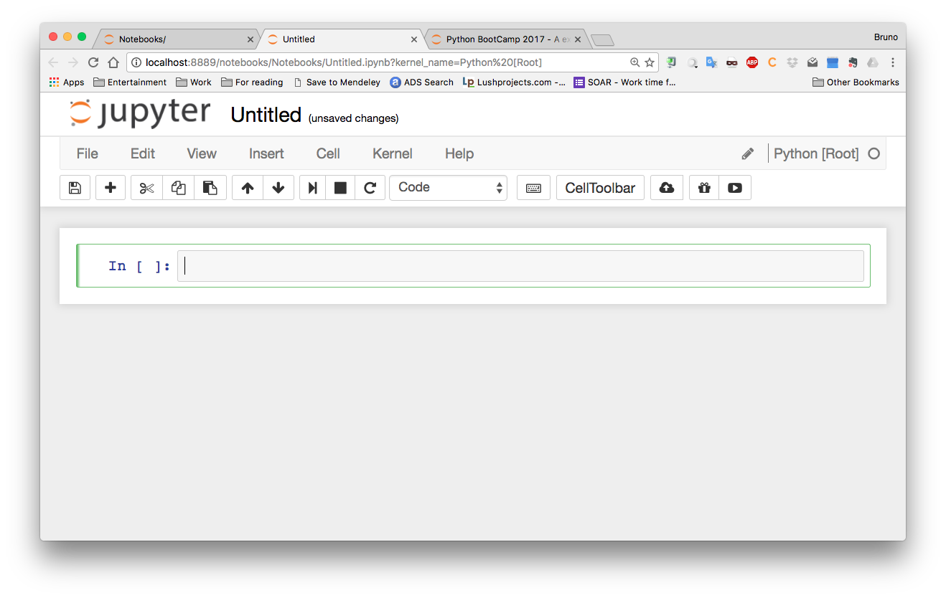
Jupyter / iPython Notebook

Slide 24
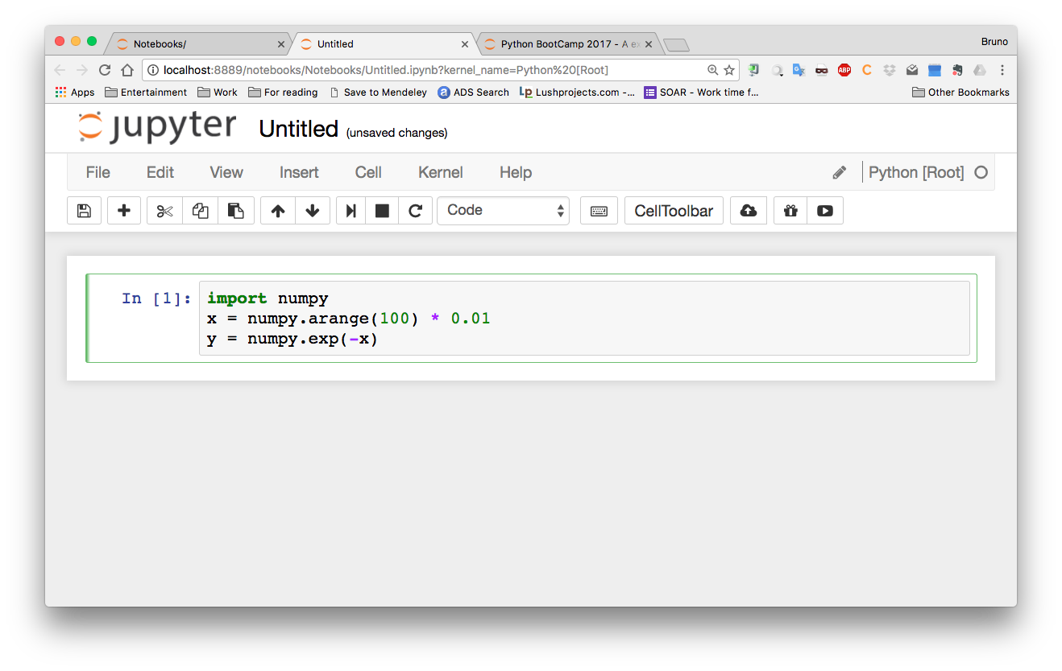
Jupyter / iPython Notebook

Slide 25
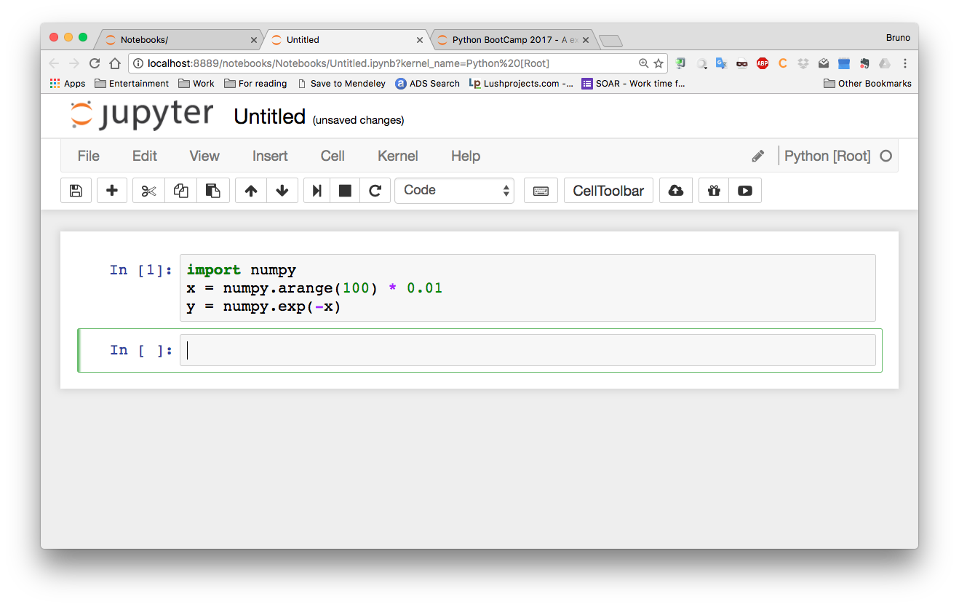
Jupyter / iPython Notebook
<ENTER>: New line
<SHIFT> + <ENTER>: Execute cell

Slide 26
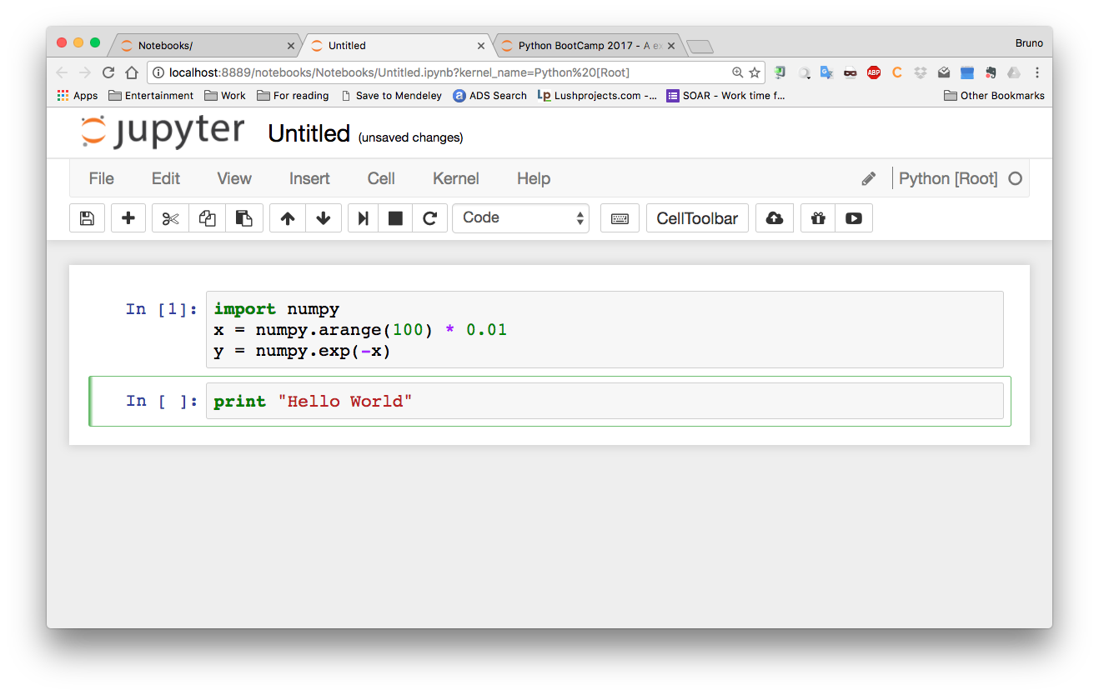
Jupyter / iPython Notebook

Slide 27
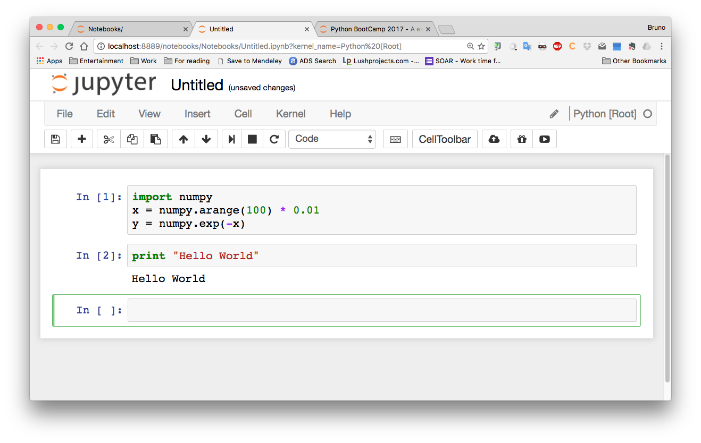
Jupyter / iPython Notebook

Slide 28
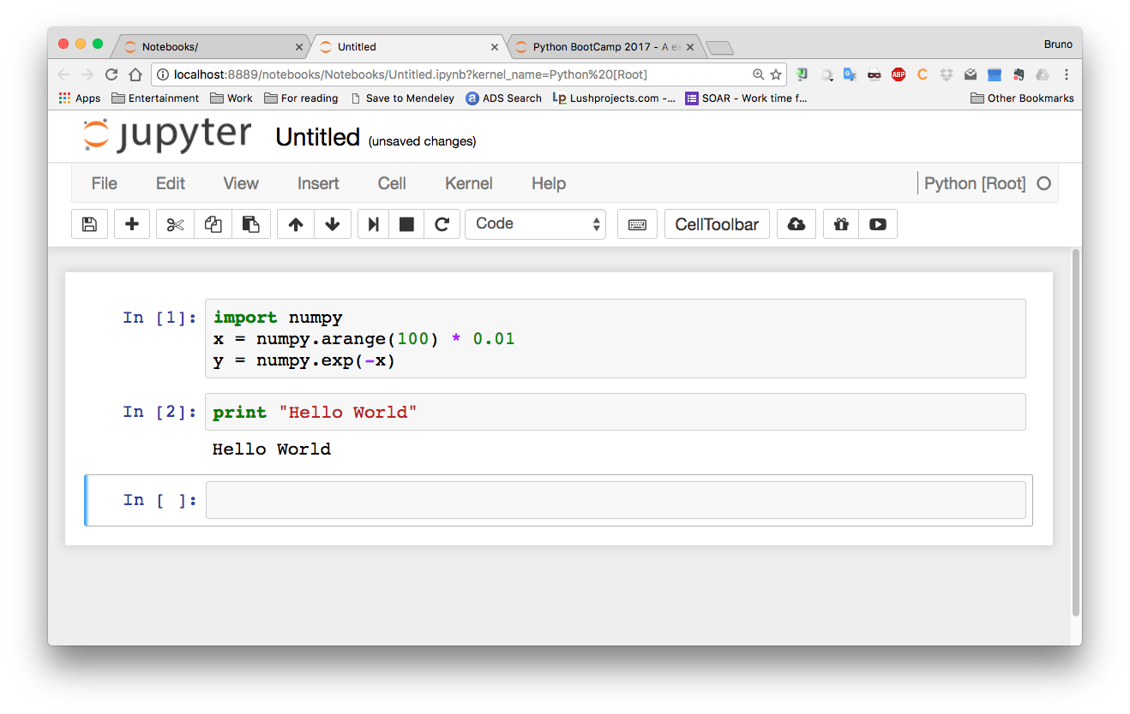
Jupyter / iPython Notebook
Command Mode

Slide 29
Jupyter / iPython Notebook
Edit Mode

Slide 30
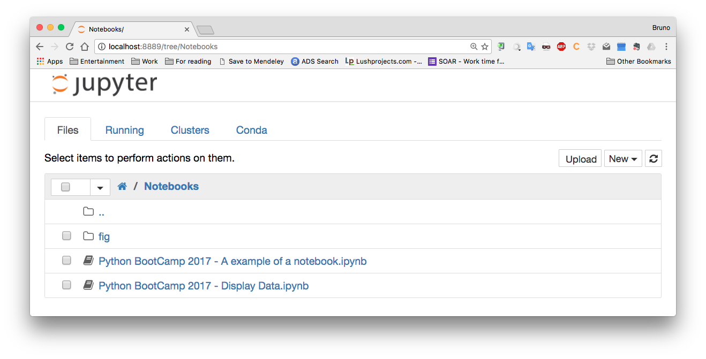
Jupyter / iPython Notebook

Slide 31
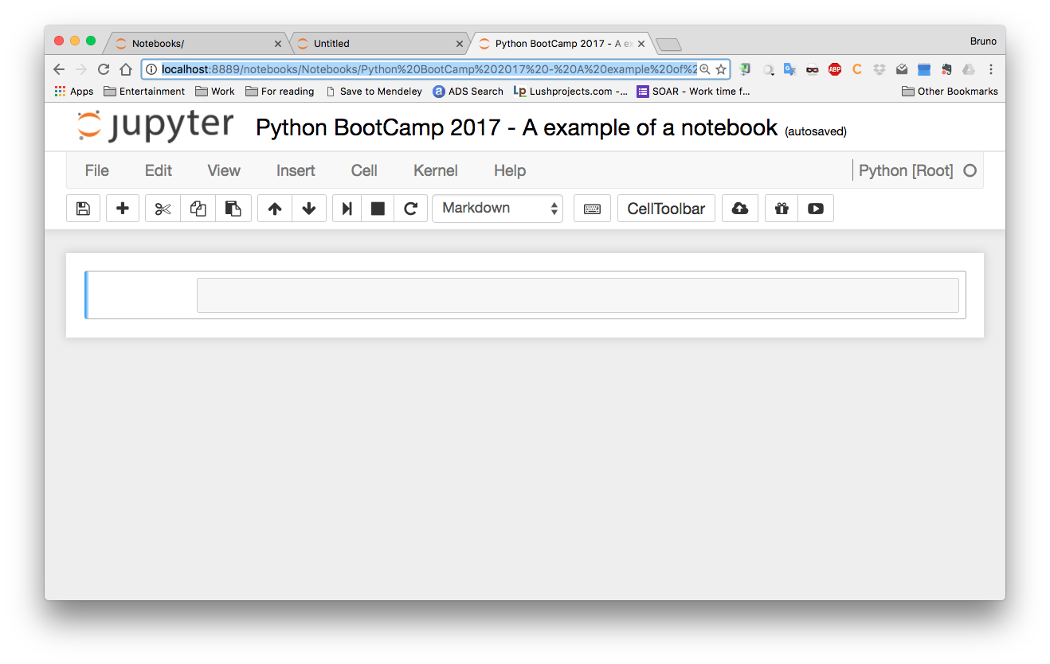
Jupyter / iPython Notebook
<m> in _command mode_: swicth to Markdown edition

Slide 32
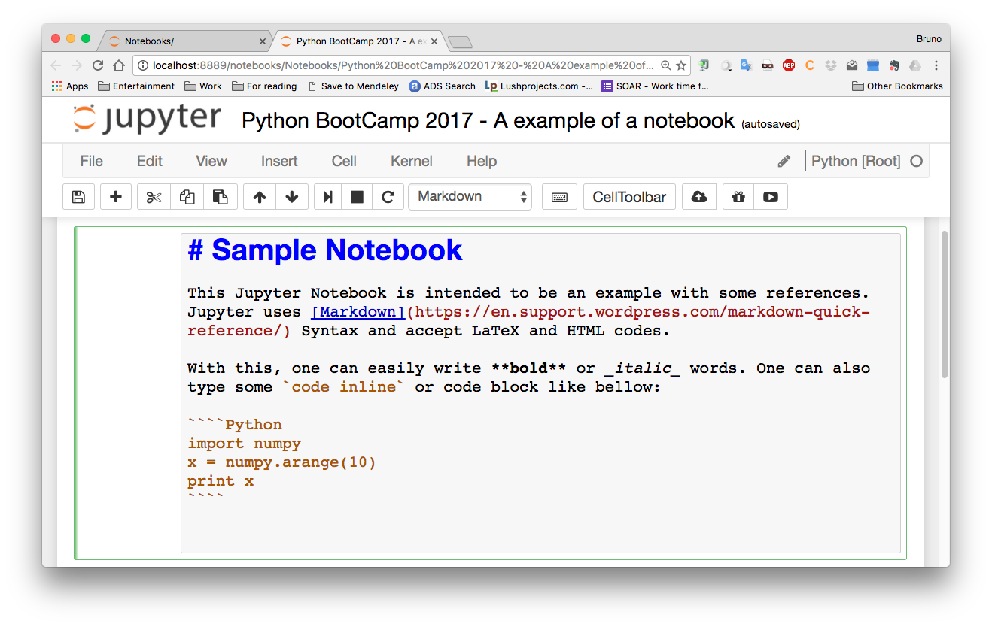
Jupyter / iPython Notebook

Slide 33
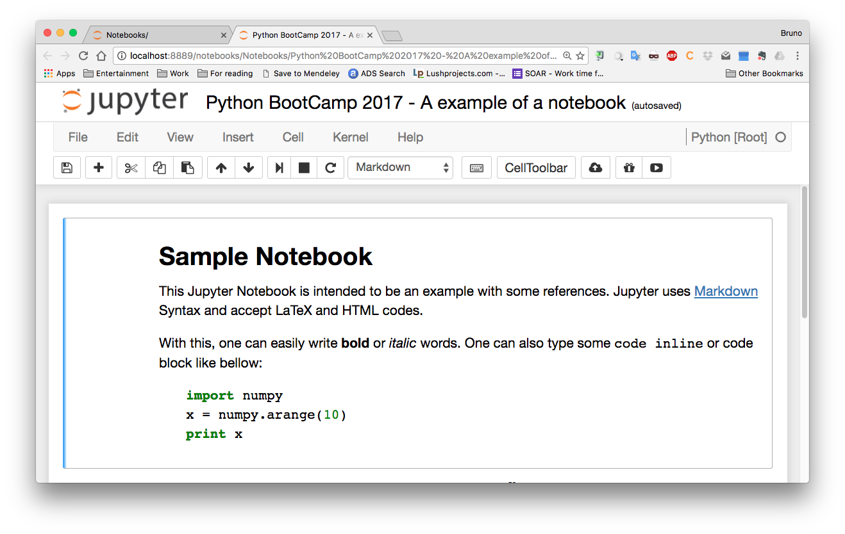
Jupyter / iPython Notebook

Slide 34
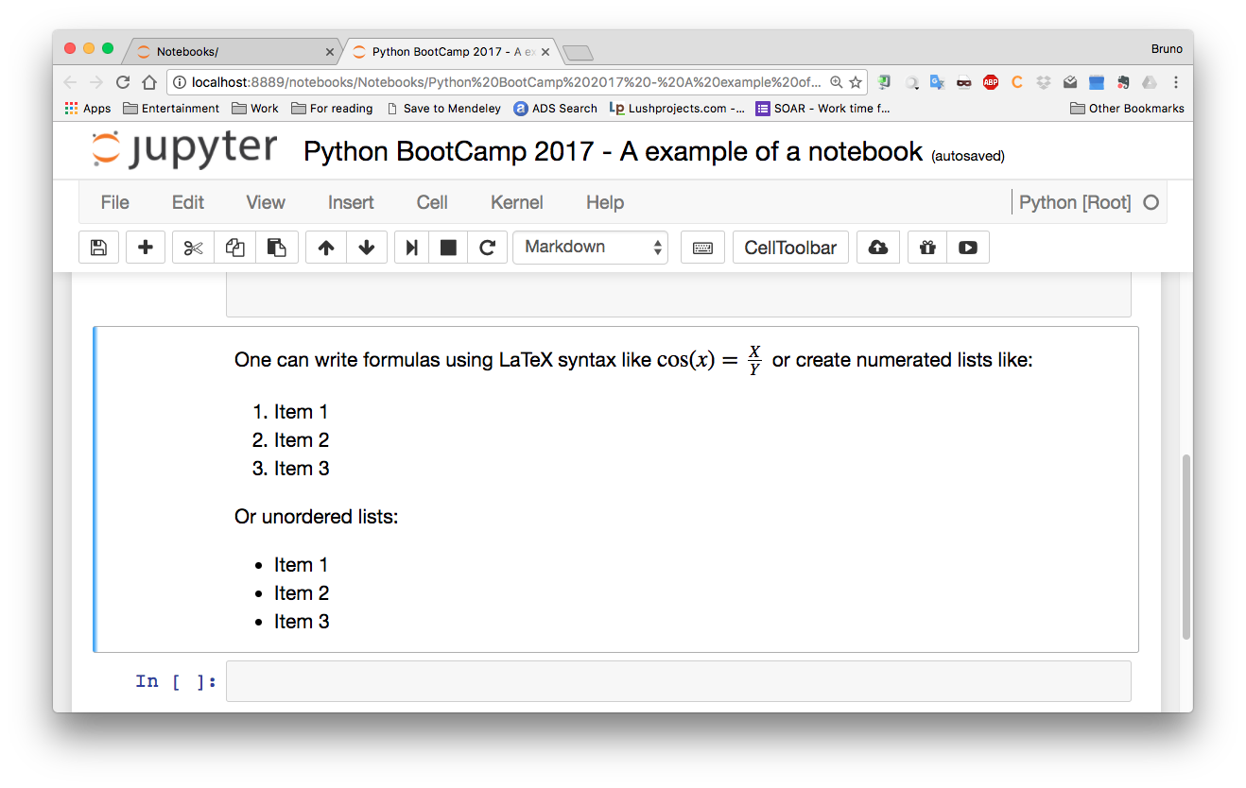
Jupyter / iPython Notebook

Slide 35
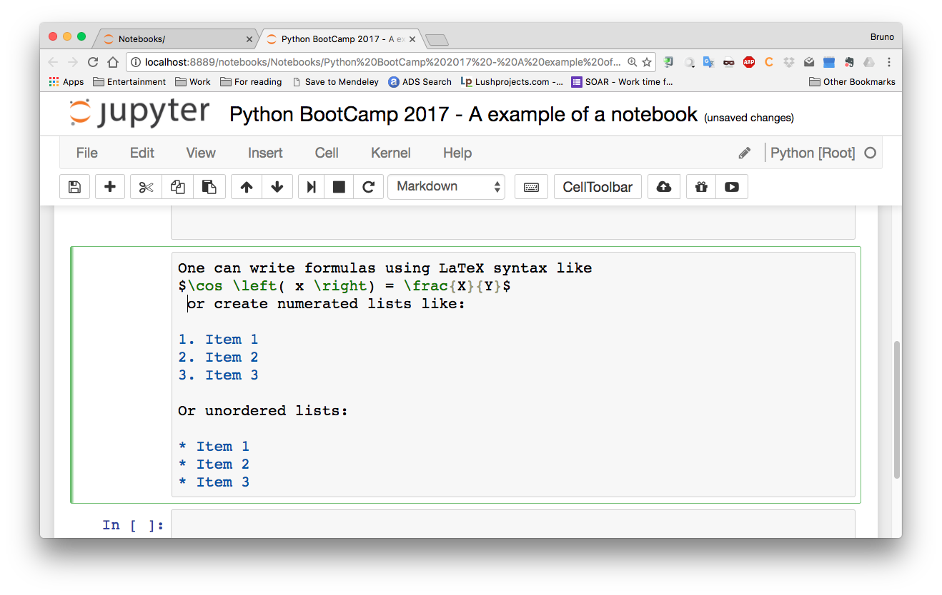
Jupyter / iPython Notebook

Slide 36
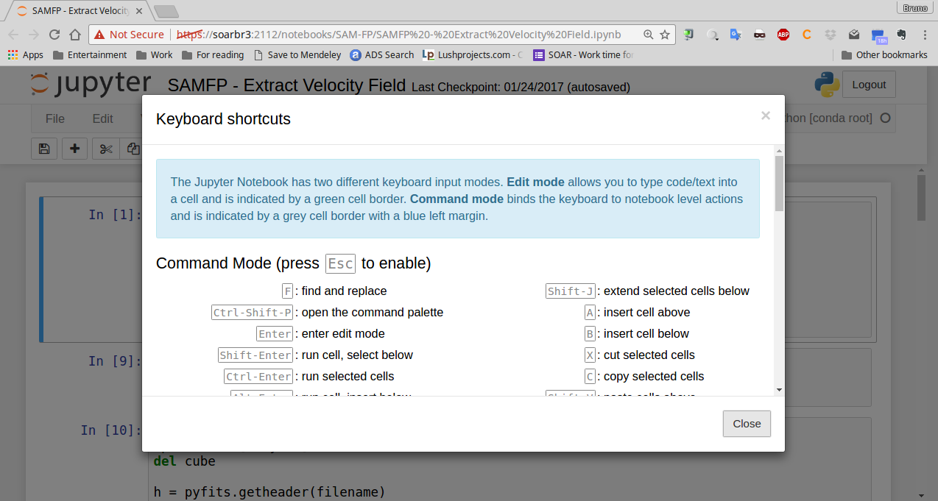
Jupyter / iPython Notebook

Slide 37
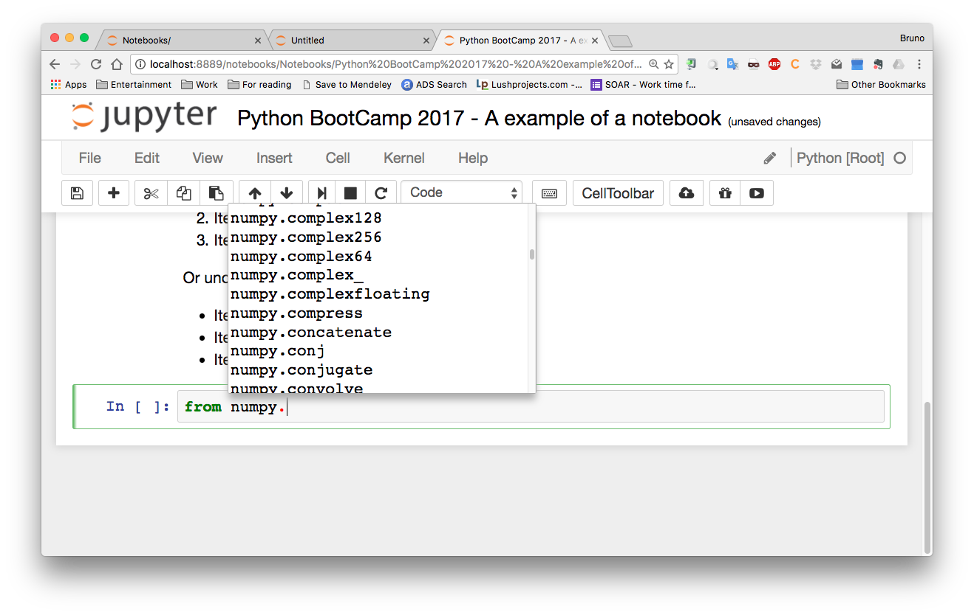
Jupyter / iPython Notebook

Slide 38
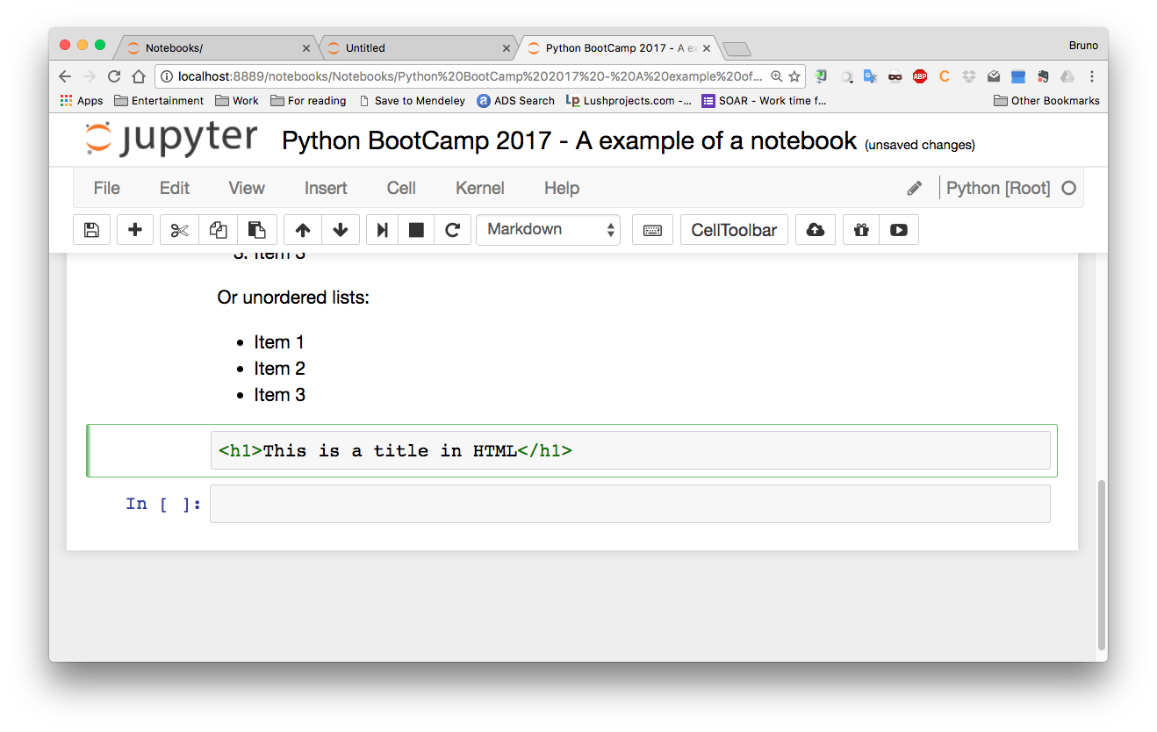
Jupyter / iPython Notebook

Slide 39
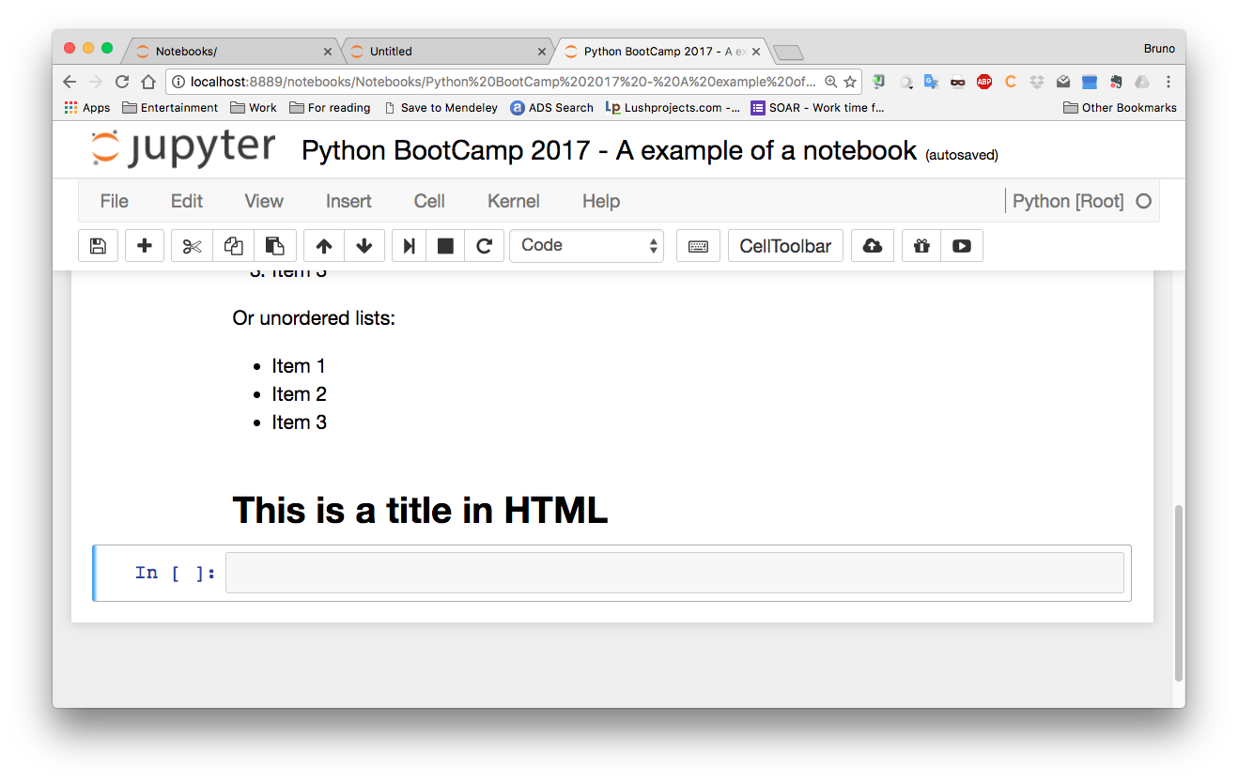
Jupyter / iPython Notebook

Slide 40
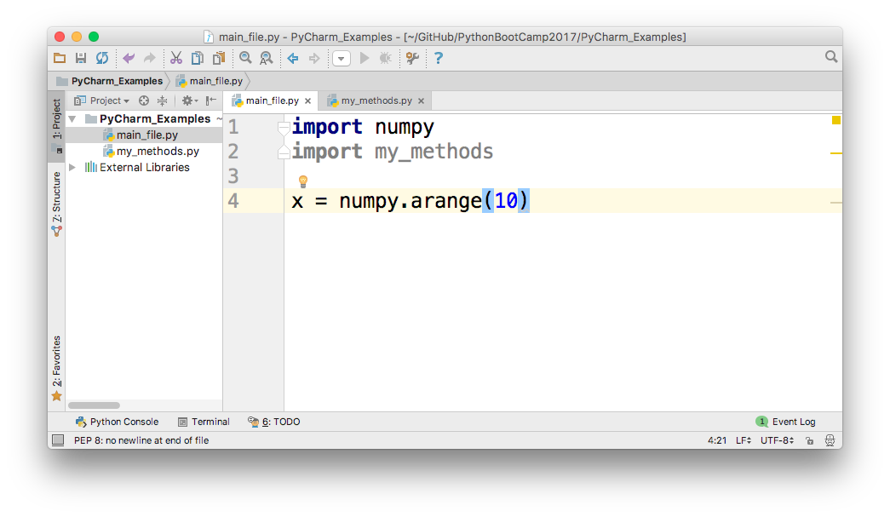
PyCharm – Not Used

Slide 41
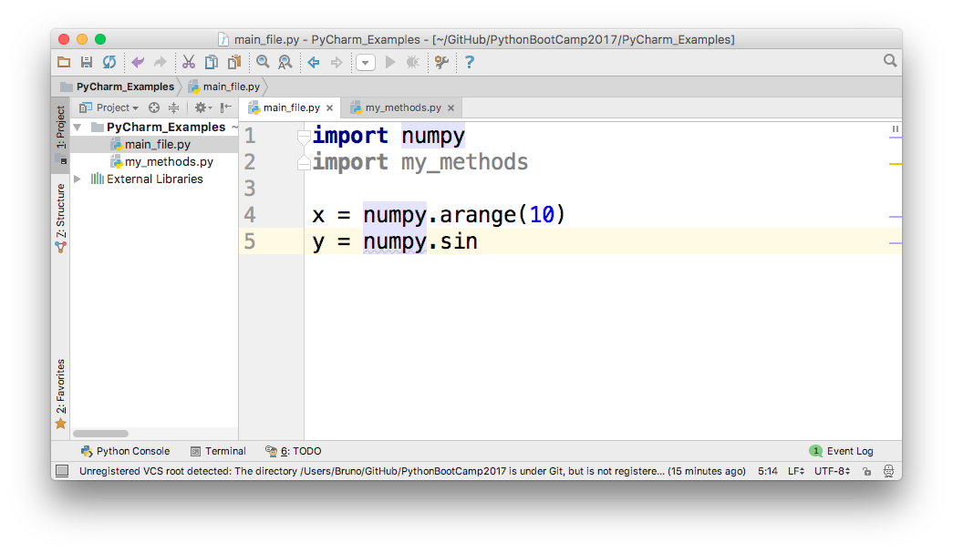
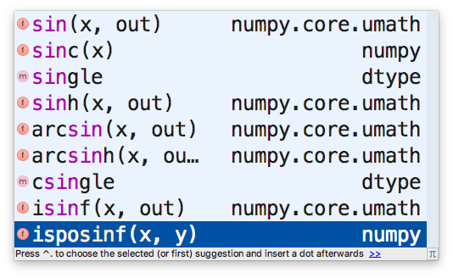
PyCharm – Tab

Slide 42
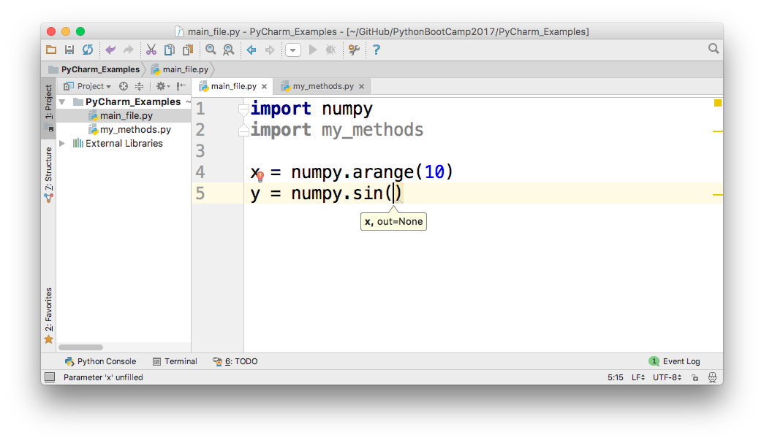
PyCharm – See parameters

Slide 43
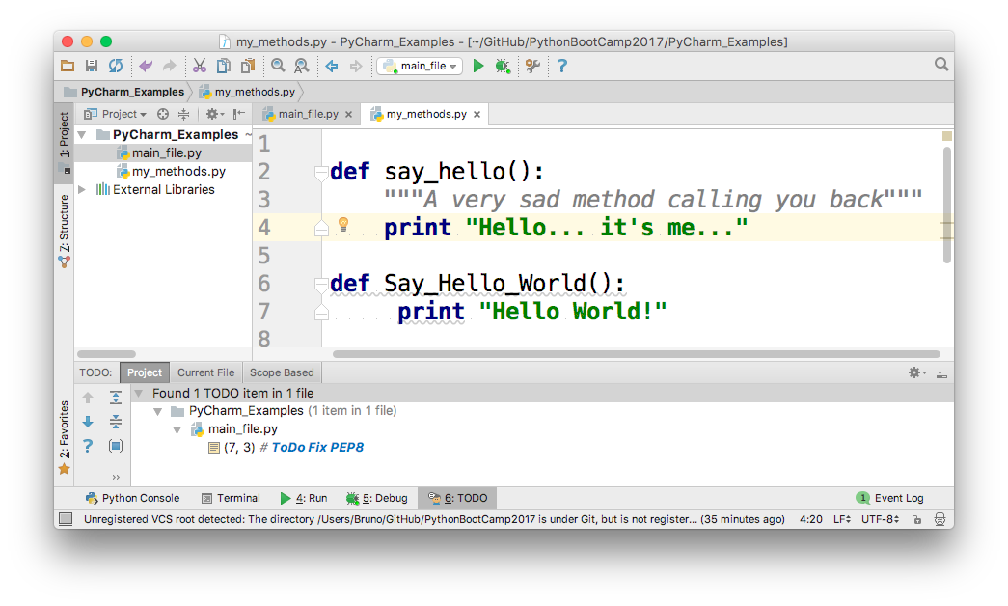
PyCharm

Slide 44
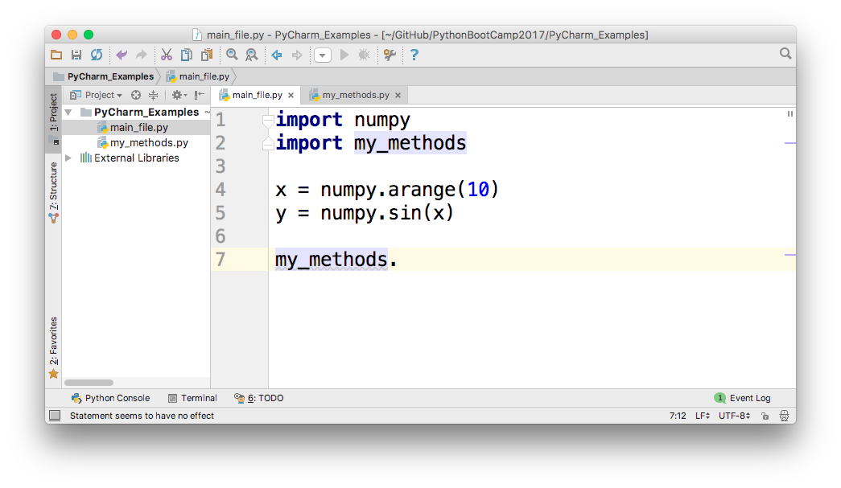
PyCharm – Auto-complete

Slide 45
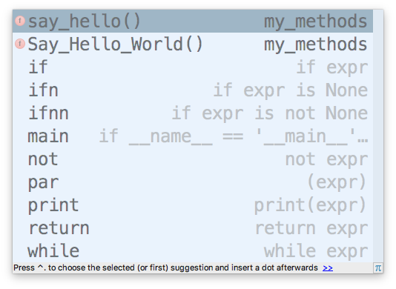
PyCharm – Auto-complete

Slide 46
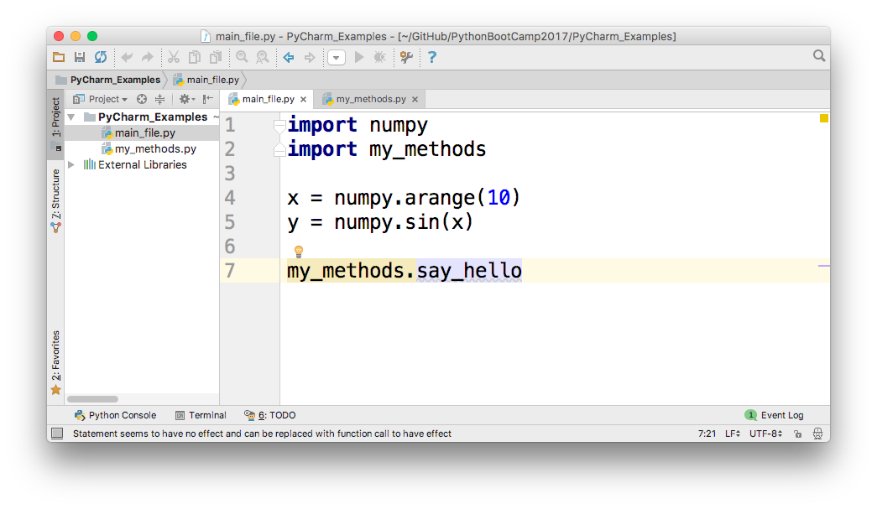
PyCharm – Quick Help

Slide 47
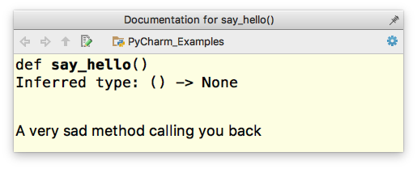
PyCharm – Quick Help

Slide 48
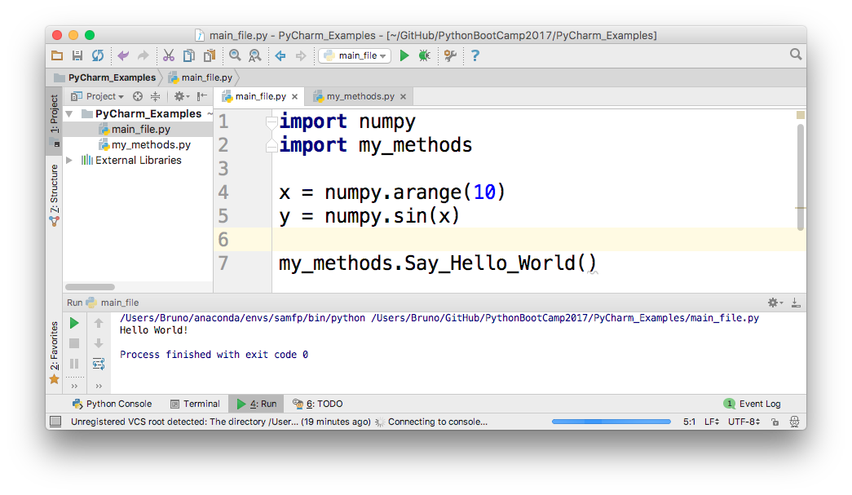
PyCharm - Run

Slide 49
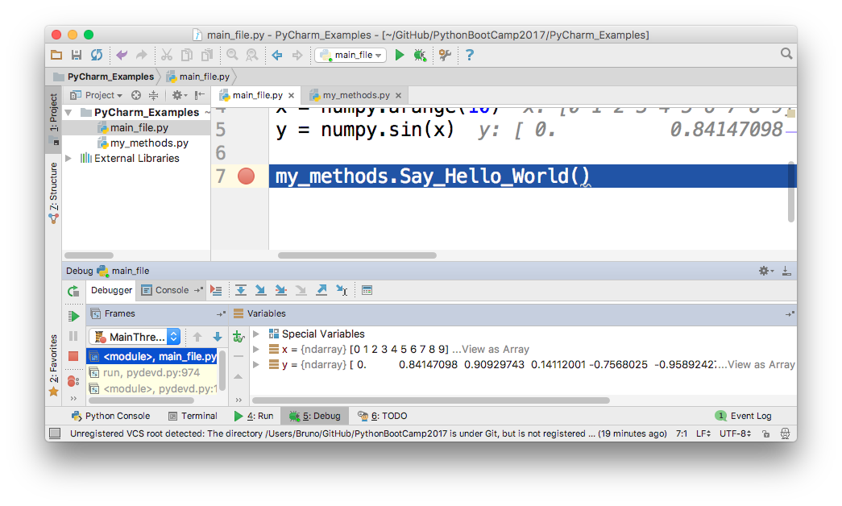
PyCharm - Debug

Slide 50
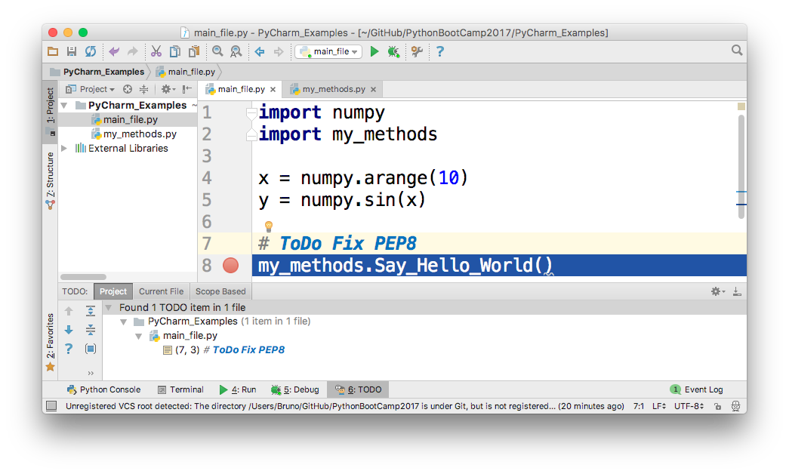
PyCharm – PEP-8

Slide 51
PyCharm – PEP-8

Slide 52
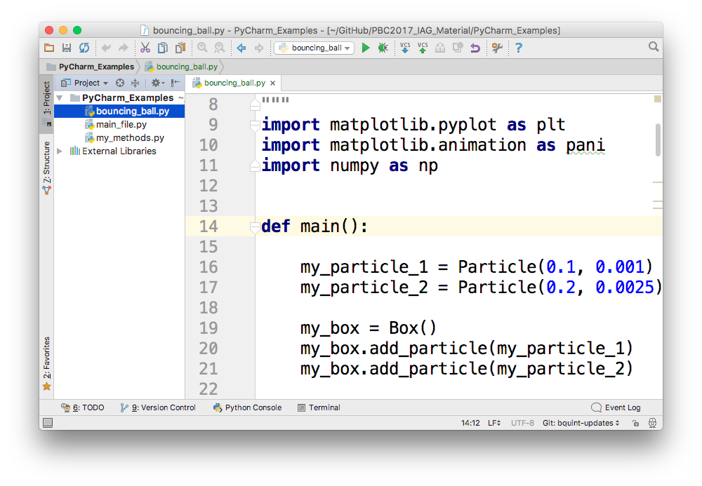
PyCharm - Structure

Slide 53
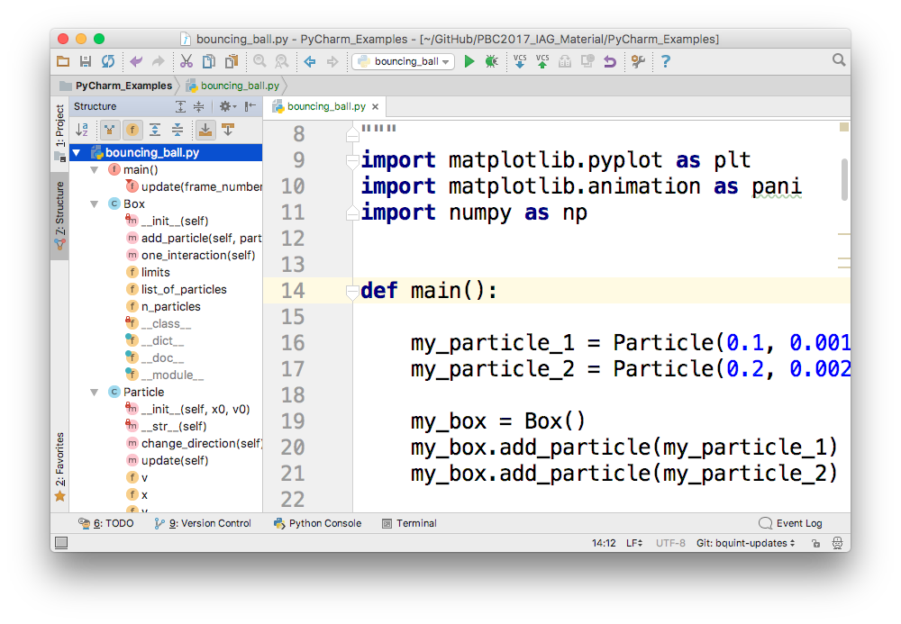
PyCharm - Structure

Slide 54
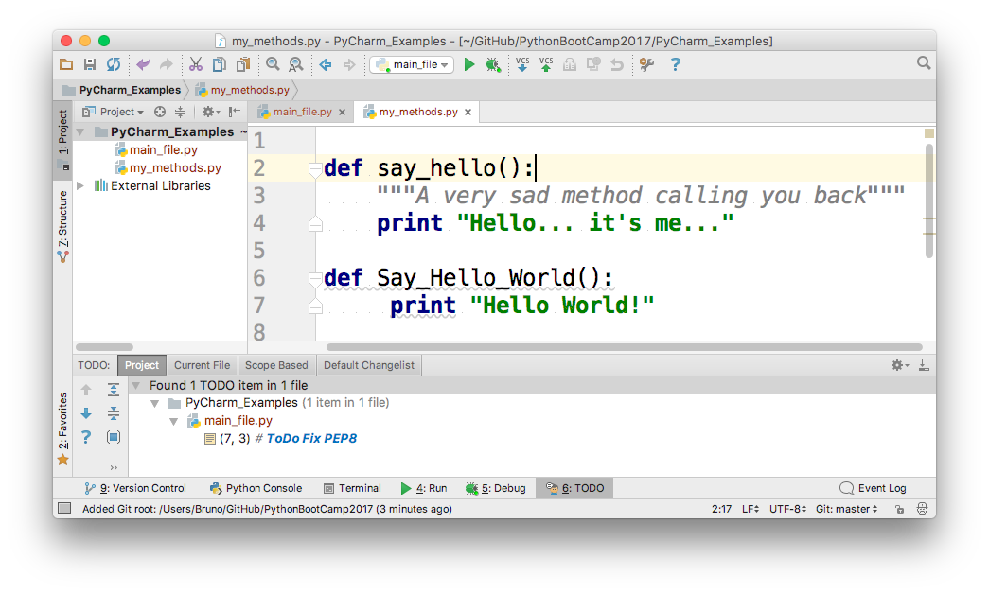
PyCharm – Version Control (Git)

Slide 55
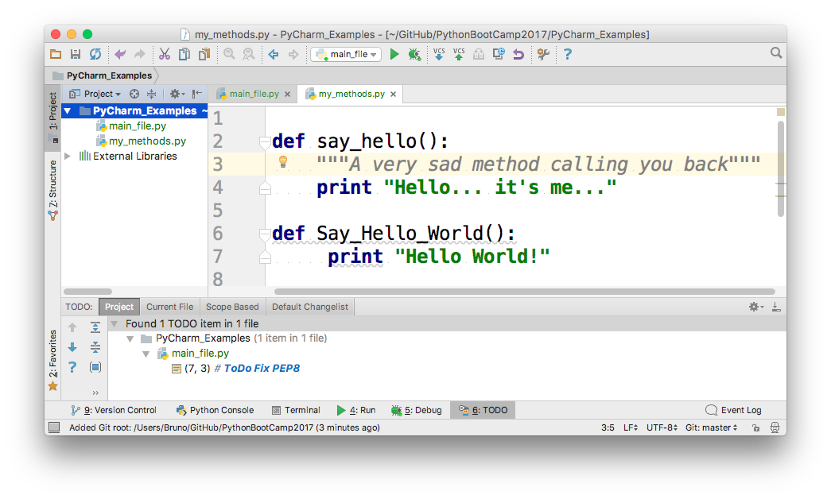
PyCharm – Version Control (Git)

Slide 56
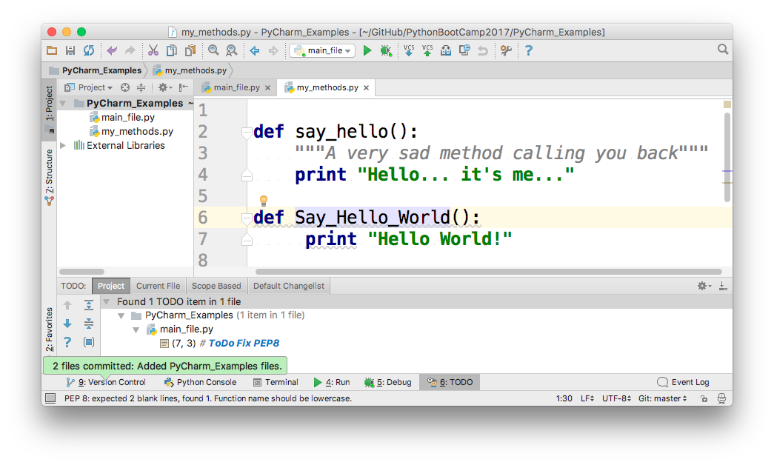
PyCharm – Version Control (Git)

Slide 57
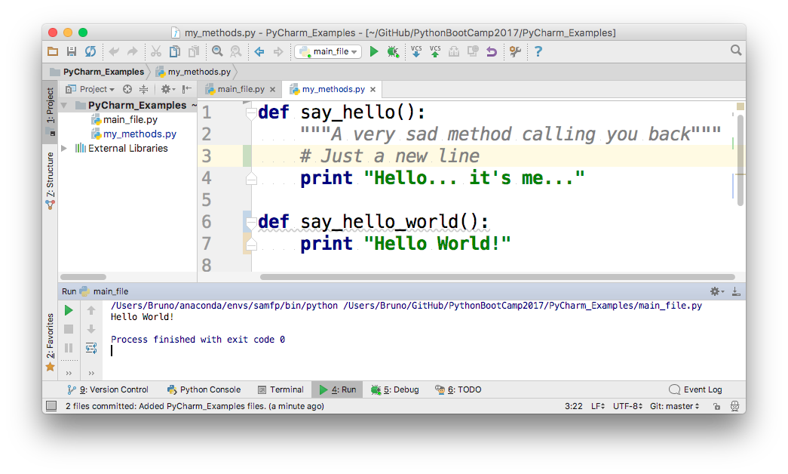
PyCharm – Version Control (Git)

Slide 58

PyCharm – Version Control (Git)

Slide 59

PyCharm – Version Control (Git)

Slide 60

Questions?

